Slide 1
Zomato Restaurants Analysis
Richin Stanly

Slide 2
Overview & Key Metrics
Total restaurants: 9551
  Countries in dataset: N/A
  Cities in dataset: 141
  Unique cuisines (approx): 145

Slide 3
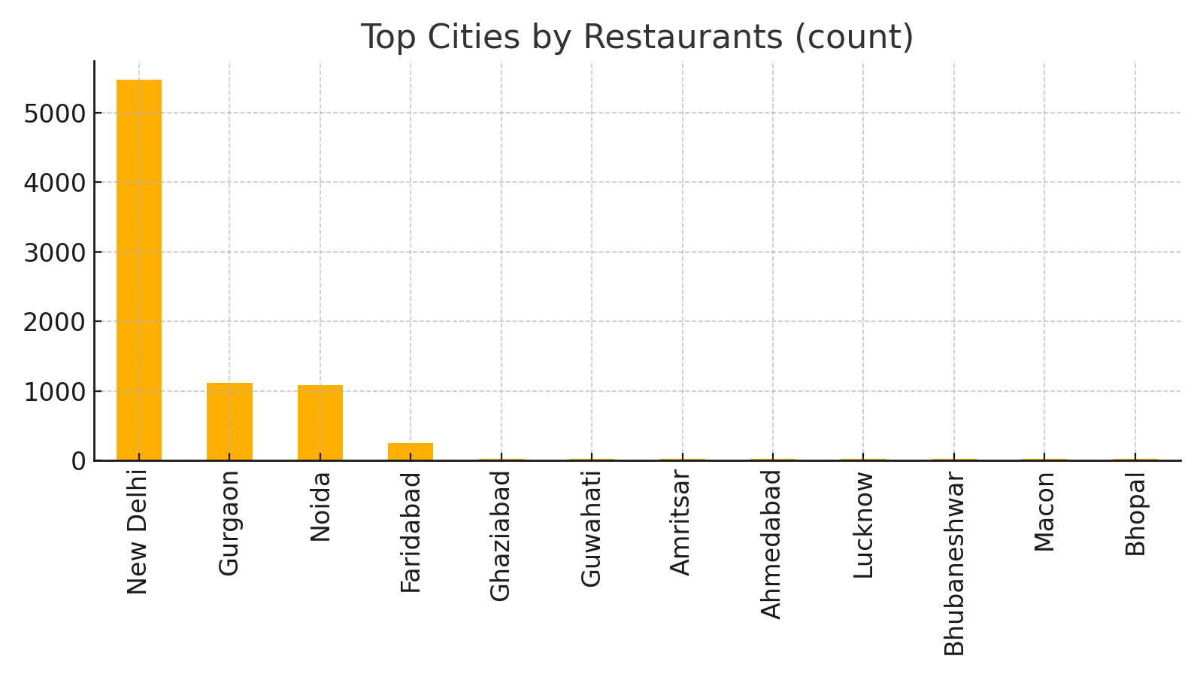
Top Cities by Restaurants

Slide 4
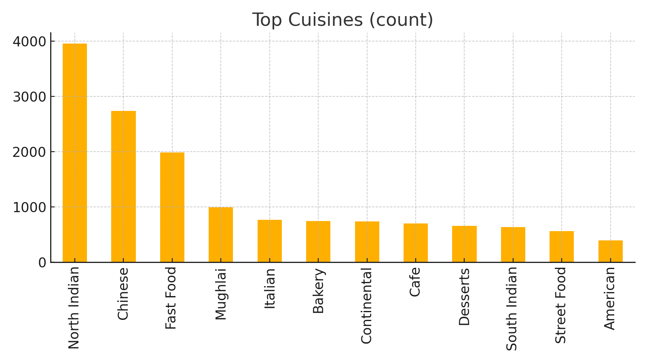
Top Cuisines

Slide 5
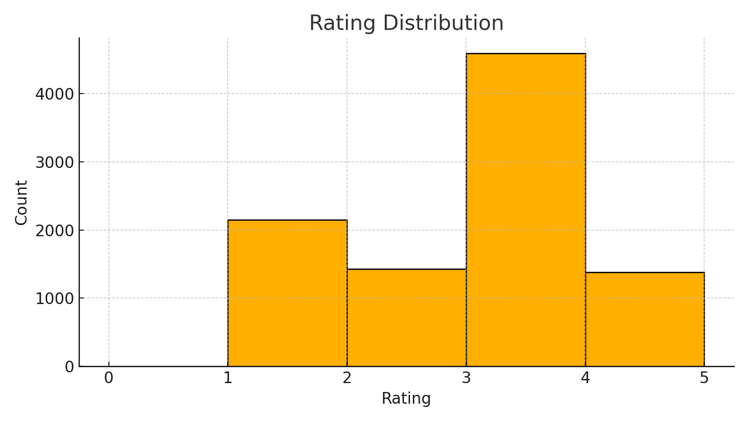
Rating Distribution

Slide 6
Auto-generated Insights
1. Majority of restaurants are concentrated in a few countries and cities.
  2. Top cuisines include North Indian, Chinese, Fast Food, Mughlai, Italian, etc.
  3. Ratings are distributed across the range; check slide for exact histogram.
  4. Table booking and online delivery availability differ by region — consider strategies per city.

Slide 7
Recommendations
• Improve service quality & consistency for low-rated restaurants.
  • Explore niche cuisines in saturated cities to stand out.
  • Promote online delivery & table booking where adoption is low.

